Slide 1

SOCIONICS
All slides are copyrighted by Jack Oliver Aaron of the World Socionics Society
A CRASH COURSE

Slide 2
6. TYPES
Part II
All slides are copyrighted by Jack Oliver Aaron of the World Socionics Society

Slide 3
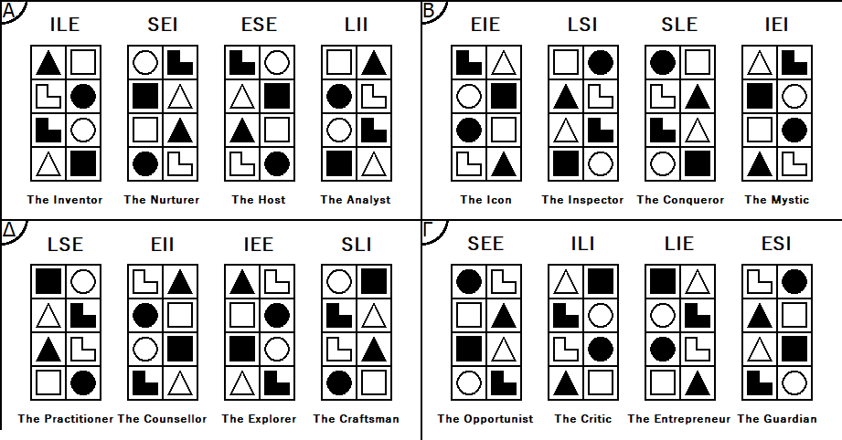
SO FAR
All slides are copyrighted by Jack Oliver Aaron of the World Socionics Society
Information Elements
Information Metabolism
Functions
8/15 Type Dichotomies
Clubs
Temperaments
Quadras

Slide 4
WHAT’S NEXT
All slides are copyrighted by Jack Oliver Aaron of the World Socionics Society
Information Elements
Information Metabolism
Functions
8/15 Type Dichotomies
Clubs
Temperaments
Quadras
The remaining 7 Type Dichotomies

Slide 5
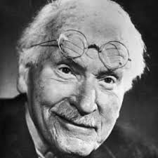
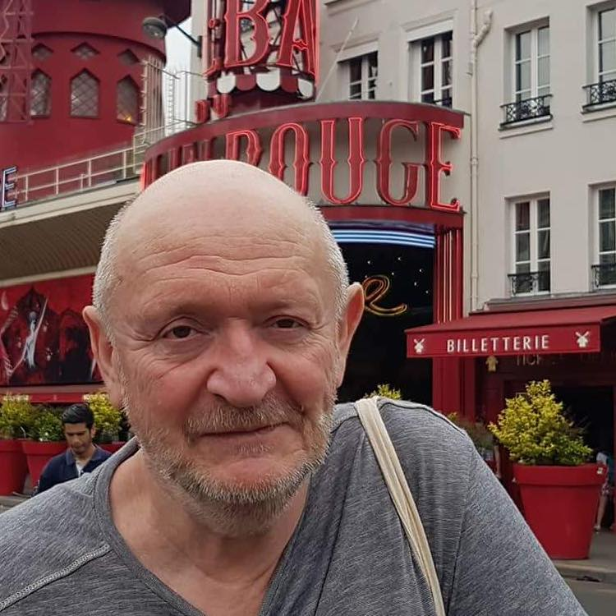
TYPE DICHOTOMIES
All slides are copyrighted by Jack Oliver Aaron of the World Socionics Society
Energiser vs. Integrator
Sensory vs. Intuitive
Logical vs. Ethical
Rational vs. Irrational
Reductionist vs. Holist
Identifier vs. Transformer
Accepter vs. Rejecter
Clarifier vs. Integrifier
Determined vs. Exacting
Contrarian vs. Obstinate
Affirmer vs. Denier
?
?
?
?

Slide 6

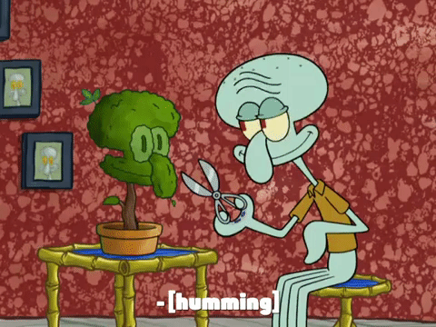
DETERMINED VS. EXACTING
All slides are copyrighted by Jack Oliver Aaron of the World Socionics Society
Determined | Exacting
Intuitive elements in Stubborn functions Sensory elements in Flexible functions Fixed in views on future outcomes Hard to persuade on the big picture Principled in what they will aim towards Traditionally called ‘Tactical’ ILE, ESE, LSI, IEI, ILI, ESI, LSE, IEE | Sensory elements in Stubborn functions Intuitive elements in Flexible functions Fixed in views on present conditions Hard to persuade on the details Principled in what they will experience Traditionally called ‘Strategic’ SEI, LII, EIE, SLE, SEE, LIE, EII, SLI

Slide 7
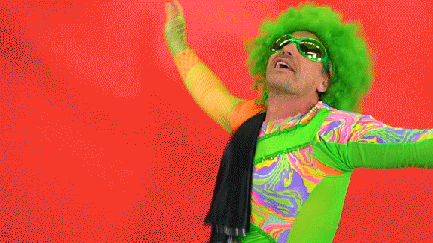

CONTRARIAN VS. OBSTINATE
All slides are copyrighted by Jack Oliver Aaron of the World Socionics Society
Contrarian | Obstinate
Ethical elements in Stubborn functions Logical elements in Flexible functions Fixed in how they are feeling Hard to persuade on how to treat others Principled on the right way to feel Traditionally called ‘Constructivist’ ILE, ESE, EIE, SLE, ILI, ESI, EII, SLI | Logical elements in Stubborn functions Ethical elements in Flexible functions Fixed in what they are thinking Hard to persuade on how things work Principled on the right way to think Traditionally called ‘Emotivist’ SEI, LII, LSI, IEI, SEE, LIE, LSE, IEE

Slide 8

AFFIRMER VS. DENIER
All slides are copyrighted by Jack Oliver Aaron of the World Socionics Society
Affirmer | Denier
Identifying Energisers affirm and pursue what they want Transforming Integrators affirm and formulate a roadmap of change Use Assertive functions for affirmation Propose and move towards something Traditionally called ‘Positivist’ ILE, ESE, LSI, IEI, SEE, LIE, EII, SLI | Identifying Integrators deny and reduce what they don’t want Transforming Energisers deny and change what needs to be changed Use Assertive functions for denial Spurn and move away from something Traditionally called ‘Negativist’ SEI, LII, EIE, SLE, ILI, ESI, LSE, IEE

Slide 9

Fourth Small Group: TOURNAMENTS
All slides are copyrighted by Jack Oliver Aaron of the World Socionics Society
Grouped by being:
Determined or Exacting
Contrarian or Obstinate
Identifying or Transforming
Share the following functions:
Stubborn & Flexible
Directly compete or clash over same principles
Unlikely to compromise with each other

Slide 10
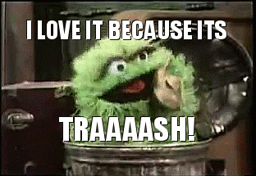

Decency - Optimism vs. Pessimism
All slides are copyrighted by Jack Oliver Aaron of the World Socionics Society
Determined & Contrarian Identifiers
Types compete/clash over what is good and acceptable
Alpha Affirmers say ‘yes’ to ideas and try to include everything
Gamma Deniers say a cautious ‘no’ to whatever has not earnt trust
ILE, ESE, ESI & ILI

Slide 11
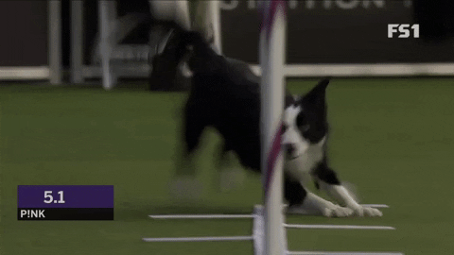

Accomplishment - Striving vs. Harmony
All slides are copyrighted by Jack Oliver Aaron of the World Socionics Society
Exacting & Obstinate Identifiers
Types compete/clash over what ought to be achieved and improved
Gamma Affirmers are impatient to cut red tape and overcome obstacles
Alpha Deniers do not want to rock the boat or break their principles
SEI, LII, SEE & LIE

Slide 12
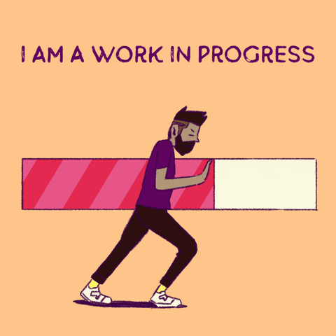

Authenticity - Substance vs. Style
All slides are copyrighted by Jack Oliver Aaron of the World Socionics Society
Exacting & Contrarian Transformers
Types compete/clash over what is deemed real and authentic to oneself
Delta Affirmers see substance of character in the desire to self-improve
Beta Deniers express a loud, stylised image to be recognised/respected
EIE, SLE, EII & SLI

Slide 13
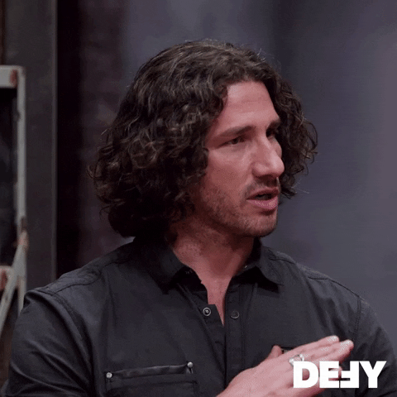
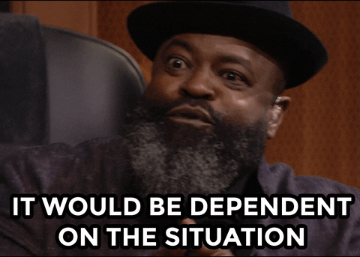
Truth - Absolutism vs. Relativism
All slides are copyrighted by Jack Oliver Aaron of the World Socionics Society
Determined & Obstinate Transformers
Types compete/clash over what can be believed to be true
Beta Affirmers set out a clear, set ideology of what is true
Delta Deniers confound ideologies by seeing each situation differently
LSI, IEI, LSE & IEE

Slide 14
NEXT TIME
All slides are copyrighted by Jack Oliver Aaron of the World Socionics Society
Energiser vs. Integrator
Sensory vs. Intuitive
Logical vs. Ethical
Rational vs. Irrational
Reductionist vs. Holist
Identifier vs. Transformer
Accepter vs. Rejecter
Clarifier vs. Integrifier
Determined vs. Exacting
Contrarian vs. Obstinate
Affirmer vs. Denier
Space-Locked vs. Time-Locked
Sight-Locked vs. Speech-Locked
?
?

Slide 15
SPACE-LOCKED VS. TIME-LOCKED
All slides are copyrighted by Jack Oliver Aaron of the World Socionics Society
Space-locked | Time-locked
Appreciating elements are Constant Repudiating elements are Variable Either confident being here or elsewhere Can balance strategy with tactics Needs help either in the detail or new ideas Traditionally called ‘Carefree’ ILE, SEI, EIE, LSI, LIE, ESI, IEE, SLI | Repudiating elements are Constant Appreciating elements are Variable Either confident acting now or in past/future Can balance innovation with logistics Needs help either in acting now or the future Traditionally called ‘Farsighted’ ESE, LII, SLE, IEI, SEE, ILI, LSE, EII

Slide 16
SIGHT-LOCKED VS. SPEECH-LOCKED
All slides are copyrighted by Jack Oliver Aaron of the World Socionics Society
Sight-locked | Speech-locked
Differentiating elements are Constant Resolving elements are Variable Either confident seeing facts or intentions Can balance charisma with consistency Needs help either in knowledge or trust Traditionally called ‘Yielding’ ILE, SEI, SLE, IEI, LIE, ESI, LSE, EII | Resolving elements are Constant Differentiating elements are Variable Either confident saying ‘‘truth’ or what appeals Can balance pragmatism with loyalty Needs help either in thinking or popularity Traditionally called ‘Obstinate’ ESE, LII, EIE, LSI, SEE, ILI, IEE, SLI

Slide 17
Fifth Small Group: AXES
All slides are copyrighted by Jack Oliver Aaron of the World Socionics Society
Grouped by being:
Space or Time-locked
Sight or Speech-locked
Identifying or Transforming
Share the following functions:
Constant & Variable
Have the same areas of consistency
Occupy different points around a shared theme

Slide 18
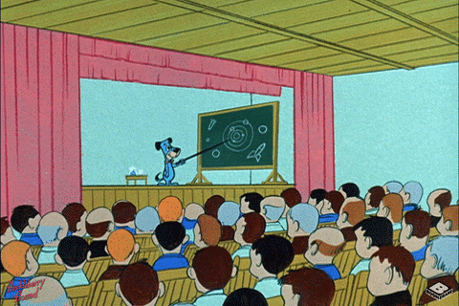
Teachers
All slides are copyrighted by Jack Oliver Aaron of the World Socionics Society
Space-locked & Sight-locked Identifiers
Extremely focused on, or totally lacking:
Innovative problem solving
Day-to-day relationship maintenance
Able to balance:
Structural analysis of long-term trends
In-the-moment persuasion
ILE, SEI, LIE & ESI

Slide 19
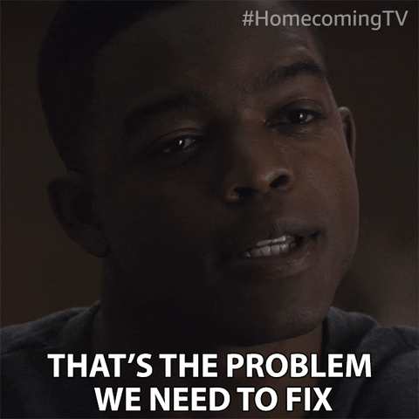
Diplomats
All slides are copyrighted by Jack Oliver Aaron of the World Socionics Society
Time-locked & Speech-locked Identifiers
Extremely focused on, or totally lacking:
Structural analysis of long-term trends
In-the-moment persuasion
Able to balance:
Innovative problem solving
Day-to-day relationship maintenance
LII, ESE, SEE & ILI

Slide 20

Activists
All slides are copyrighted by Jack Oliver Aaron of the World Socionics Society
Space-locked & Speech-locked Transformers
Extremely focused on, or totally lacking:
Creative charisma
Meticulous systemising
Able to balance:
Quick-thinking pragmatism
Deep personal reflection
EIE, LSI, IEE & SLI

Slide 21

Artists
All slides are copyrighted by Jack Oliver Aaron of the World Socionics Society
Time-locked & Sight-locked Transformers
Extremely focused on, or totally lacking:
Quick-thinking pragmatism
Deep personal reflection
Able to balance:
Creative charisma
Meticulous systemising
SLE, IEI, LSE & EII

Slide 22
TYPE DICHOTOMIES
All slides are copyrighted by Jack Oliver Aaron of the World Socionics Society
Energiser vs. Integrator
Sensory vs. Intuitive
Logical vs. Ethical
Rational vs. Irrational
Reductionist vs. Holist
Identifier vs. Transformer
Accepter vs. Rejecter
Clarifier vs. Integrifier
Determined vs. Exacting
Contrarian vs. Obstinate
Affirmer vs. Denier
Space-Locked vs. Time-Locked
Sight-Locked vs. Speech-Locked
Thetic vs. Antithetic
Clockwise vs. Anticlockwise

Slide 23
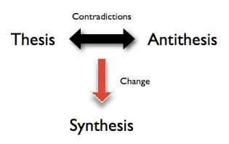
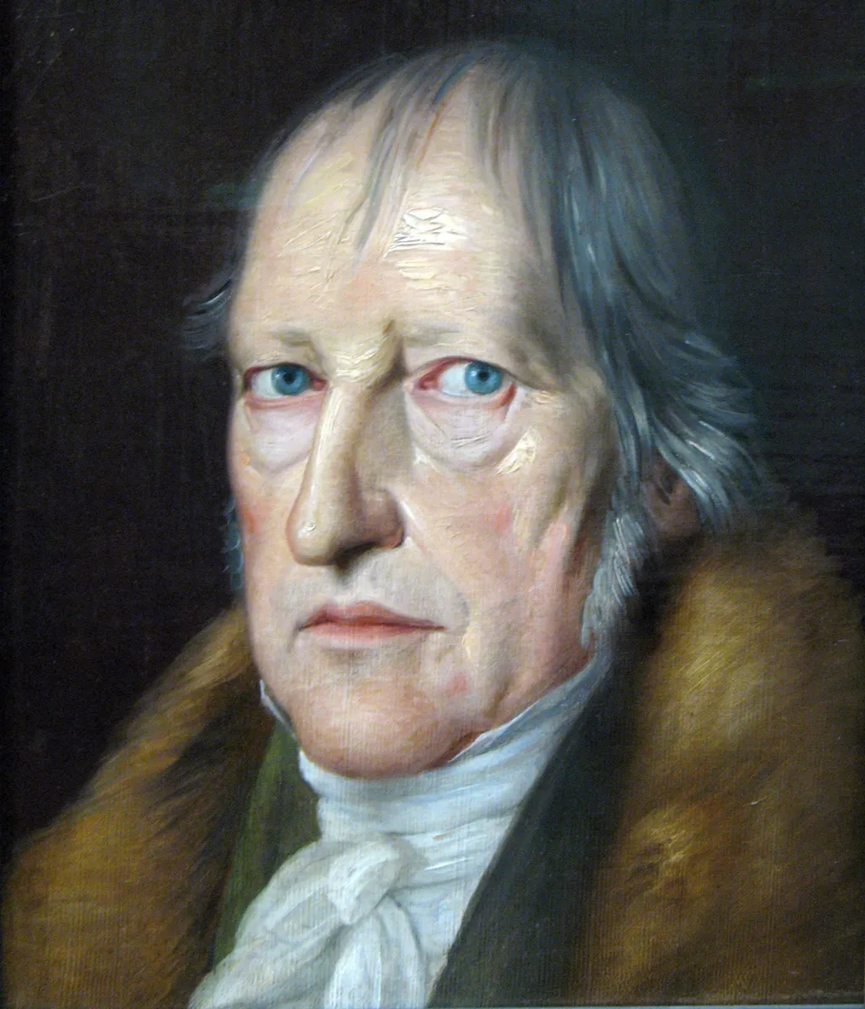
THETIC VS. ANTITHETIC
All slides are copyrighted by Jack Oliver Aaron of the World Socionics Society
Thetic | Antithetic
Holistic Identifiers Reductionistic Transformers Club is aligned with Quadra Temperament unstable for Quadra Sets out the valued path Attains a sustainable balance SEI, ESE, LSI, SLE, ILI, LIE, EII, IEE | Reductionistic Identifiers Holistic Transformers Club is at odds with Quadra Temperament stabilises Quadra Introduces crucial element from outside Is brought onto the right path ILE, LII, EIE, IEI, SEE, ESI, LSE, SLI

Slide 24
CLOCKWISE VS. ANTICLOCKWISE
All slides are copyrighted by Jack Oliver Aaron of the World Socionics Society
Clockwise | Anticlockwise
Identifying Irrationals Transforming Rationals When dualised, enable society to progress ILE, SEI, EIE, LSI, SEE, ILI, LSE, EII | Identifying Rationals Transforming Irrationals When dualised, delay progress of society ESE, LII, SLE, IEI, LIE, ESI, IEE, SLI
Leading
Demonstrative
Mobilising
Role

Slide 25
Sixth Small Group: STANDOFFS
All slides are copyrighted by Jack Oliver Aaron of the World Socionics Society
Grouped by being:
Affirmer or Denier
Clockwise or Anticlockwise
Reductionist or Holist
Share the following:
Cyclical relationship of Supervision
Each type has clear view of the weaknesses of the next type
Also called ‘cognitive styles’ by Gulenko

Slide 26
Proposer
All slides are copyrighted by Jack Oliver Aaron of the World Socionics Society
Clockwise & Reductionist Affirmers
Characterised by obsessions they must advocate for progress
Need to have their views doubted and challenged to be vindicated
Each sees a significant flaw in the next Proposer’s proposition
-> ILE -> LSI -> SEE -> EII ->

Slide 27
Doubter
All slides are copyrighted by Jack Oliver Aaron of the World Socionics Society
Clockwise & Holistic Deniers
Characterised by doubt with uncertainty on how to progress
Need to be gradually brought on board with a positive proposition
Each sees the next Doubter’s doubt as overblown
-> SEI -> EIE -> ILI -> LSE ->

Slide 28
Cycler
All slides are copyrighted by Jack Oliver Aaron of the World Socionics Society
Anticlockwise & Holistic Affirmers
Characterised by affirmation for its own sake, leading to a cycle
Need a disruption to free themselves out of their ruts
Each sees how the next Cycler’s cycle is needlessly perpetuated
-> ESE -> SLI -> LIE -> IEI ->

Slide 29
Disrupter
All slides are copyrighted by Jack Oliver Aaron of the World Socionics Society
Anticlockwise & Reductionistic Deniers
Characterised by dismantling problems without a solution in its place
Need to ensure they don’t run out of things to disrupt
Each see the wanton destruction of the next Disrupter
-> LII -> IEE -> ESI -> SLE ->

Slide 30
Seventh Small Group: COURSES
All slides are copyrighted by Jack Oliver Aaron of the World Socionics Society
Grouped by being:
Clockwise or Anti-clockwise
Antithetic or Thetic
Energiser or Integrator
Share the following:
Cyclical relationship of Benefit
Each type grows towards the next type in the Course
Play the same role in carrying out/hindering progress

Slide 31
Figureheads
All slides are copyrighted by Jack Oliver Aaron of the World Socionics Society
Clockwise & Antithetic Energisers
Brings something from beyond the quadra
Uses this to revitalise norms and lead through change
Discover new ways to lead by growing towards next Figurehead
-> ILE -> EIE -> SEE -> LSE ->

Slide 32
Cardinals
All slides are copyrighted by Jack Oliver Aaron of the World Socionics Society
Clockwise & Thetic Integrators
Knows and safeguards the values of their quadra
Make decisions behind the throne to keep things aligned
Better protect values by growing towards next Cardinal
-> SEI -> LSI -> ILI -> EII ->

Slide 33
Crusaders
All slides are copyrighted by Jack Oliver Aaron of the World Socionics Society
Anticlockwise & Thetic Energisers
Overt and brash in representing their quadra values
React to other values by overcharging their own
Further amplify their effect by growing towards next Crusader
-> ESE -> IEE -> LIE -> SLE ->

Slide 34
Healer
All slides are copyrighted by Jack Oliver Aaron of the World Socionics Society
Anticlockwise & Antithetic Integrators
Root out problems and provide better focus to others
Support by dismantling or smoothing over-zealous actions
Better identify and correct issues by growing towards next Healer
-> LII -> SLI -> ESI -> IEI ->

Slide 35
What we learned…
 | Type Dichotomies
1 | Energiser | Integrator
2 | Sensor | Intuitor
3 | Logician | Ethicist
4 | Rational | Irrational
5 | Reductionist | Holist
6 | Identifier | Transformer
7 | Accepter | Rejecter
8 | Clarifier | Integrifier
9 | Determined | Exacting
10 | Contrarian | Obstinate
11 | Affirmer | Denier
12 | Space-Locked | Time-Locked
13 | Sight-Locked | Speech-Locked
14 | Thetic | Antithetic
15 | Clockwise | Anticlockwise
All slides are copyrighted by Jack Oliver Aaron of the World Socionics Society

Slide 36
What we learned…
Type Dichotomies | Small Group
Intuitor + Logician + Identifier | Intellectual
Sensor + Ethicist + Identifier | Socialite
Intuitor + Ethicist + Transformer | Humanitarian
Sensor + Logician + Transformer | Realist
Energiser + Irrational + Reductionist | Acquisitive
Integrator + Rational + Reductionist | Normative
Energiser + Rational + Holist | Obliging
Integrator + Irrational + Holist | Aligning
Accepter + Clarifier + Identifier | Alpha
Rejecter + Clarifier + Transformer | Beta
Rejecter + Integrifier + Identifier | Gamma
Accepter + Integrifier + Transformer | Delta
Determined + Contrarian + Identifier | Decency
Exacting + Obstinate + Identifier | Accomplishment
Determined + Obstinate + Transformer | Truth
Exacting + Contrarian + Transformer | Authenticity
Type Dichotomies | Small Group
Space-Locked + Sight-Locked + Identifier | Teacher
Time-Locked + Speech-Locked + Identifier | Diplomat
Space-Locked + Speech-Locked + Transformer | Activist
Time-Locked + Sight-Locked + Transformer | Artist
Clockwise + Reductionist + Affirmer | Proposer
Clockwise + Holist + Denier | Doubter
Anticlockwise + Holist + Affirmer | Cycler
Anticlockwise + Reductionist + Denier | Disrupter
Clockwise + Energiser + Antithetic | Figurehead
Clockwise + Integrator + Thetic | Cardinal
Anticlockwise + Energiser + Thetic | Crusader
Anticlockwise + Integrator + Antithetic | Healer
All slides are copyrighted by Jack Oliver Aaron of the World Socionics Society

Slide 37
16 Types
Quadra | Club | Temperament | Tournament | Axis | Standoff | Course | Name | Type
Alpha | Intellectual | Acquisitive | Decency | Teacher | Proposer | Figurehead | Innovator | ILE
Alpha | Socialite | Aligning | Accomplishment | Teacher | Doubter | Cardinal | Nurturer | SEI
Alpha | Socialite | Obliging | Decency | Diplomat | Cycler | Crusader | Host | ESE
Alpha | Intellectual | Normative | Accomplishment | Diplomat | Disrupter | Healer | Analyst | LII
Beta | Humanitarian | Obliging | Authenticity | Activist | Doubter | Figurehead | Icon | EIE
Beta | Realist | Normative | Truth | Activist | Proposer | Cardinal | Inspector | LSI
Beta | Realist | Acquisitive | Authenticity | Artist | Disrupter | Crusader | Conqueror | SLE
Beta | Humanitarian | Aligning | Truth | Artist | Cycler | Healer | Mystic | IEI
Gamma | Socialite | Acquisitive | Accomplishment | Diplomat | Proposer | Figurehead | Opportunist | SEE
Gamma | Intellectual | Aligning | Decency | Diplomat | Doubter | Cardinal | Critic | ILI
Gamma | Intellectual | Obliging | Accomplishment | Teacher | Cycler | Crusader | Entrepreneur | LIE
Gamma | Socialite | Normative | Decency | Teacher | Disrupter | Healer | Guardian | ESI
Delta | Realist | Obliging | Truth | Artist | Doubter | Figurehead | Practitioner | LSE
Delta | Humanitarian | Normative | Authenticity | Artist | Proposer | Cardinal | Counsellor | EII
Delta | Humanitarian | Acquisitive | Truth | Activist | Disrupter | Crusader | Explorer | IEE
Delta | Realist | Aligning | Authenticity | Activist | Cycler | Healer | Craftsman | SLI
All slides are copyrighted by Jack Oliver Aaron of the World Socionics Society

Slide 38
Any Questions?
All slides are copyrighted by Jack Oliver Aaron of the World Socionics Society
Email Jack at worldsocionics@hotmail.com

